Slide 1
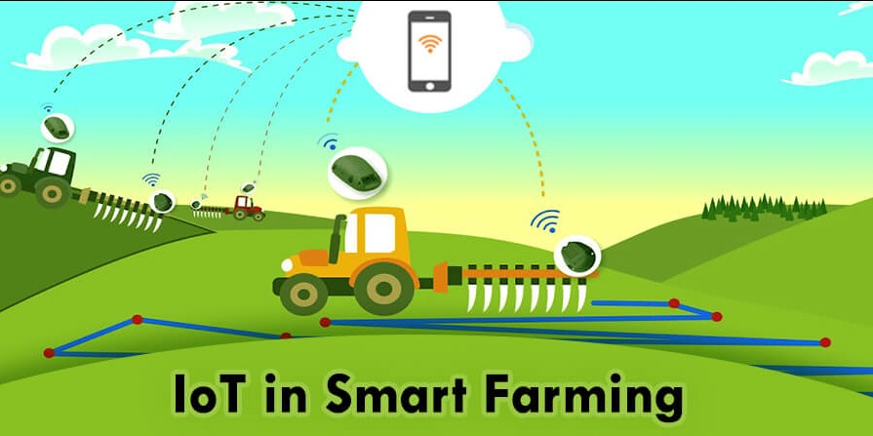
WE2 ANDROID APPLICATION
Let us lead from darkness to light
Done by:
Vinston Raja . R <winstonroja@gmail.com>
Ramya . S <ramya9600434700@gmail.com>
Santhiya . S <sanjothi99@gmail.com>
vasantha .V <vasantha190600@gmail.com>

Slide 2
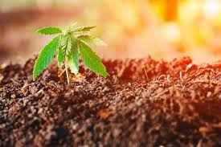
We2-Android Application
Overview of We2 application:
We2 is a android app developed to help farmer by providing relevant information to them quickly as possible.
The farmers are provided with good platform to rent or buy things.
By this app farmers are provided with a direct link to get required machines and provisions .There is no need of an external negotiator or an intermediator to get their required machines.
In addition to the dealers information they can get information about the weather report also .

Slide 3
Description:
This application acts as an interface between farmer who wants to rent their tractors or any other machines related to farming .
The unique feature in this app is that it can give information about the nearby users of tractors ,etc.
The main aim of this application is to empower farmer in the best and efficient manner.
Suppose take an instance, if the farmer doesn’t have any of the machine to do farming but the farmer has a plot for cultivation and the interest in cultivation ,here is the place where our app stands by helping the farmer in getting those machines for rent for certain period of time.
We2 app provides service to the farmer .i.e. customers can search the product in their own area.

Slide 4
Purpose:
This app makes to feel that each and every one can do farming .
To enhance farmer income,to raise their productivity and revenue by using this technology is the main aim
This is because agriculture has been one of the important sector in many countries for connecting rural areas to other countries.
We2 can satisfy few important problems faced by the farmers such as :
Cannot afford to buy a tractor.
Water pumps etc.

Slide 5
Critical:
This app can be based on Java script API , html5 and google maps.
This app can be built using android studio app for android users and apple’s objective c or swift language for iOS users.
First of all we must design an algorithm that automatically detect the location and provide response for the nearest tractor user.
We can use different technology for different platform .
This app is a best platform to the farmers to have profit.
The farmers using our application has to first register with our application and login to the system and access the application with username and password.

Slide 6
Attributes | Data types | Description
Name | String | Name of the user
User id | Alphanumeric | Id of the user which is a primary key ,that is not null
Password | Alphanumeric | Password should be in combination of 1 to 8 characters
Confirm password | alphanumeric | Password should be in combination of 1 to 8 characters

Slide 7
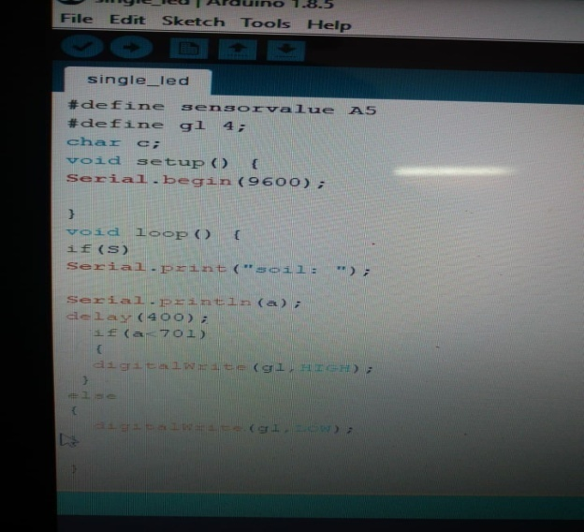
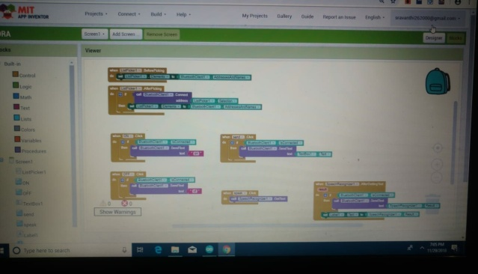
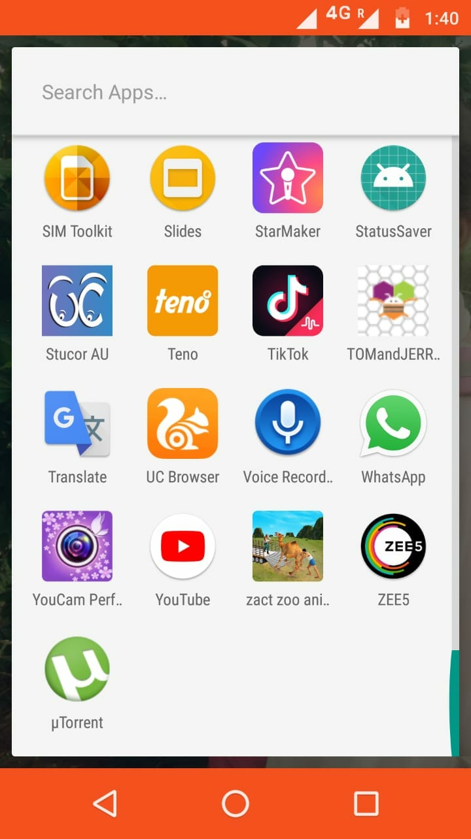
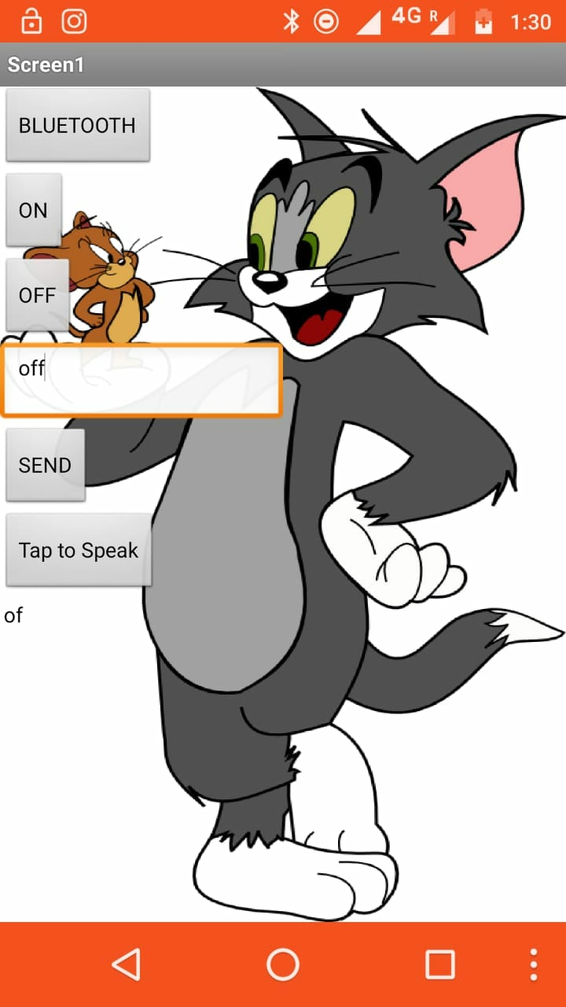

Slide 8
Database frame:
load data data
get data
L
list adapter
start
insert
query
layout
database

Slide 9
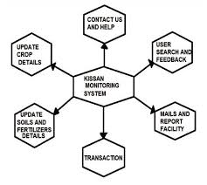

Slide 10
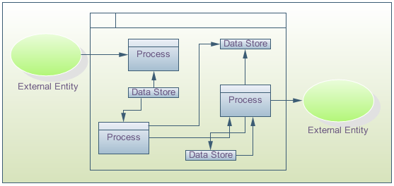
Data flow diagram:

Slide 11
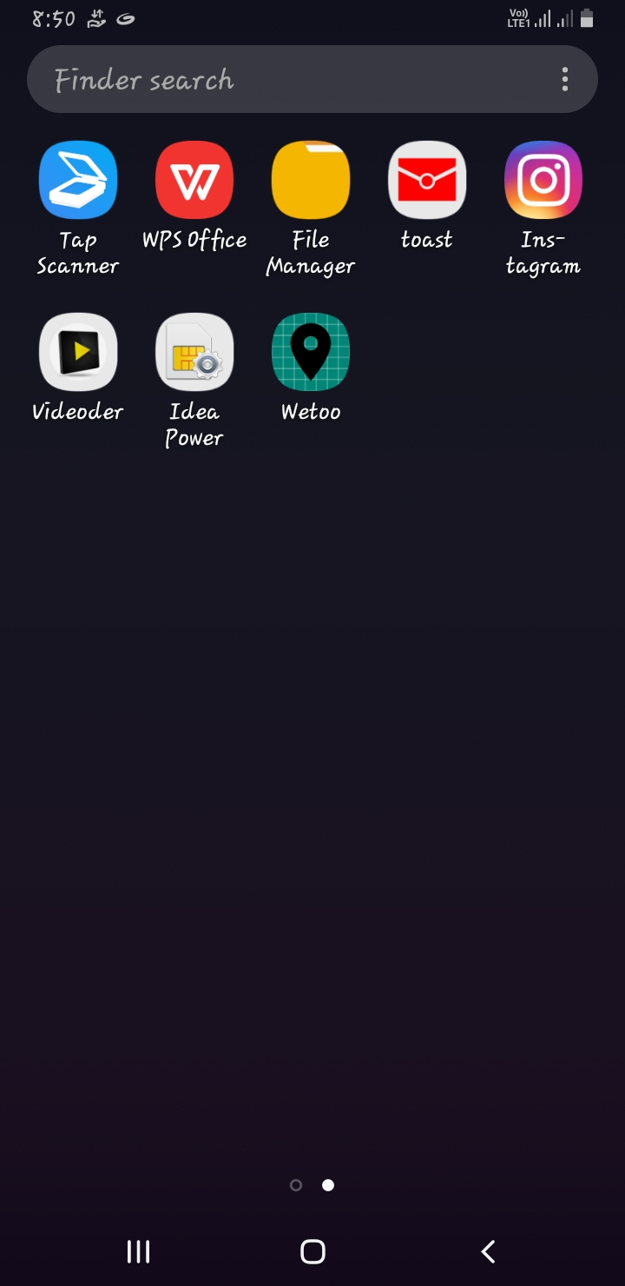
21/01/19

Slide 12
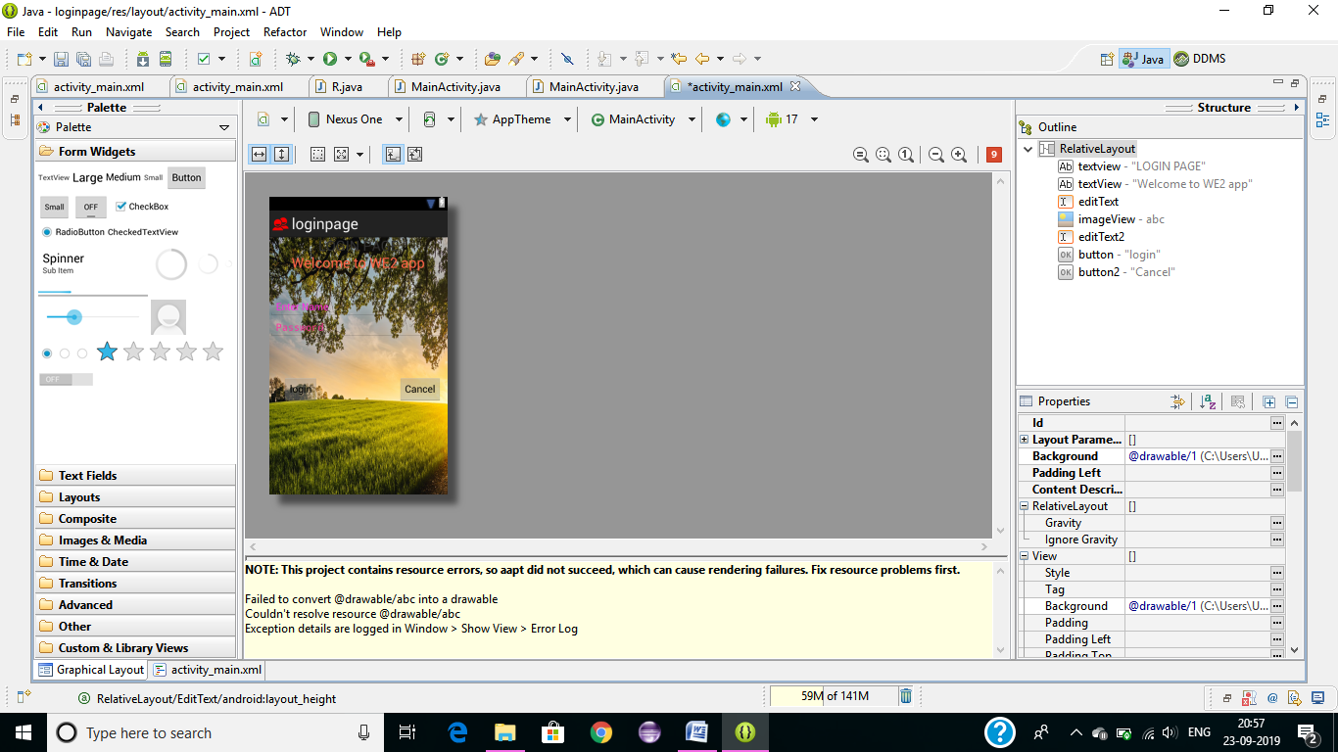
21/01/19

Slide 13
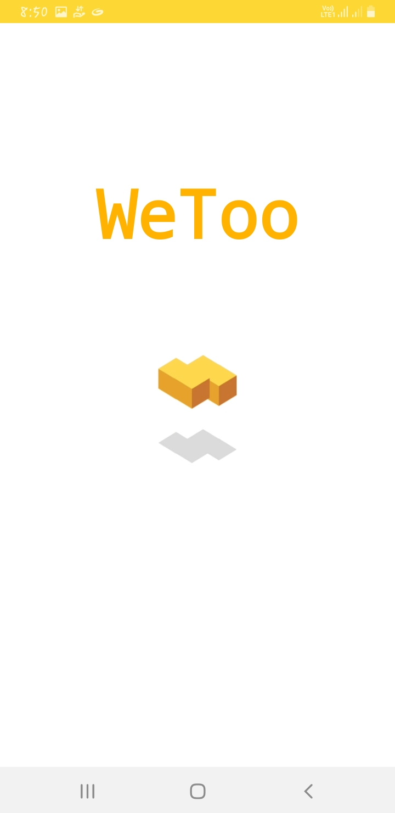
21/01/19

Slide 14
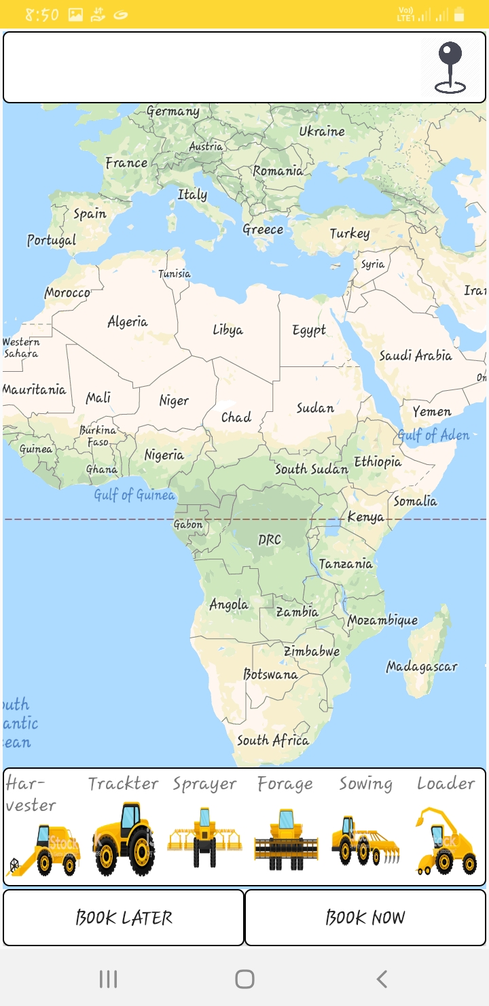
21/01/19

Slide 15
Algorithm:
First of all this we2 application is a cloud based chat service tat means it needs some centralised server to provide all the services. There are three essential parts. They are
sender
receiver
server
The message that is sent to the server it stores it and sends it to the receiver .But it is not as simple as we say .There are lots of issues in it.
The server holds the message for the receiver until it comes online and says “i am online ,give me my messages” and the server sends all the holding messages with time stamps.
Most essential task of the server is to hold all the unsent messages for billions of different users with sender’s id .so the server needs to have a unique key for each users to store all the messages and other essential informations .This is how messages are stored for each user when they are offline.
Our first try was simple and stupid...
1.Make a request and save coordinates.
2.Make another request and animate the tractor.
As we guessed there was several problems with it. we cant animate tractors properly as it moves through field ,forest,lakes and quarters
As the solution for this problem ,we used Open Street Map Routing Machine(OSRM)for building routes and one algorithm improved .
We make a request for tractors.
Save coordinate.
Send saved coordinates to the back end.
Build route via OSRM.
Return it to client app and animate tractor.
We decided to go for second iteration, because several things needed for improving the algorithm...
First thing was a trip cost calculator .All the calculators were on the tractor owner side. On the other hand its a farmer app ,so we need to duplicate data and save it on the server side.
Moreover, we have lots of problem with GPS module on the owner side .GPS problems are associated with the owner side.
Mainly we had a one major problem to solve .i.e. how to save the mobile data that is present?
As you see we watched for several protocols
HTTP
TCP
UDP
WEB SOCKETS
and for us the ideal option was UDP, because...
we send only datagram.
We don't need any guarantees.
minimalism.
saves mobile data.
we have only 20 bytes overhead.
this is not blocked in our country

Slide 16
Future work:
We2 is a mobile app developed to help farmers by providing relevant information to them quickly.
With click of a button, they can get the information on weather of current day , dealers. India have been added to empower farmers in the best possible manner.
We2 Android Application Provides (Administrator) features like fertilizers update, Contact us, Help information, also the user (customer) search available.

